Slide 1
IABIN Component 3 Project
Data Integration and Analysis Gateway
(IABIN DIAG)
A Web-Based Application
to Integrate, Visualize, Analyze and Share
IABIN Thematic Network Data

Slide 2
Presentation Topics
Introduction to IABIN DIAG Component 3 Project
Background to Data Basin
Status of Data Integration from TNs
Demonstration of IABIN DIAG tool and functions
Next Steps

Slide 3
IABIN DIAG Project: Objective
Develop a prototype Data Basin application for the IABIN Data Integration and Analysis Center that will:
Facilitate the integration, visualization, query, analysis and sharing of Thematic Network data.
Enable the structure use of this data to guide conservation and development decisions at national and regional scales.

Slide 4
IABIN DIAG Project Activities
Aggregate all IABIN TN datasets into secure web gateway that can control and monitor use and downloads of data.
Maintain clear attribution to data sources and Thematic Networks.
Make it easy for users to select topics and areas of interest, and to integrate subsets of the TN data for visualization, analysis and reporting.
Enable integration of TN data with other important datasets to provide appropriate context for user defined applications.
Create ability to implement structured queries of selected datasets -- and generate visual and written reports.

Slide 5
IABIN DIAG Project
Create a dynamic link between the IABIN.net and the IABIN DIAG application that will be transparent to system users.
Perform IABIN DIAG demonstrations and training.
Prepare for the ongoing refinement of the DIAG to reflect the evolving needs of IABIN partners, clients and stakeholders.

Slide 6
INFORMATION
DECISION SUPPORT DATABASE
DECISION-MAKERS
Ability to upload and download data
Ability to securely manage data in Work Groups
Map browser for data search, identify and visualize
Data integration to create and save new maps
Drawing & buffering functions to delineate “areas of interest”
Ability to share data and maps with selected groups.
Ability to run simple queries and generate visual and written reports
Ability to link to detailed analytical tools
IABIN DIAG
IABIN Portal: Thematic Networks
National Planning and Permitting Agencies
Scientists and the Conservation
Community
Multi-Lateral Development Banks
Corporations and Consultants
Civil Society
Ecosystem TN
Species and Specimen TN
Pollinators TN
Invasives TN
Protected Areas TN
Data Basin Information Holdings
ANALYTICAL METHODS AND TOOLS
Analyses
National Biodiversity Strategy and Actions Plans
National and Regional Planning Permitting and Planning Processes
Mitigation, Compensation and Offset
Climate Change Adaptation
Corridor Analysis
Existing Tools, e.g.:
Other Information Portals
NatureServe Vista
Climate Change Calculators
IDB
GeoSur
TNC
CIAT
ESRI
Others
MARXAN
Environmental
Flow Analysis
ESRI ArcInfo
InVest
Maxent

Slide 7
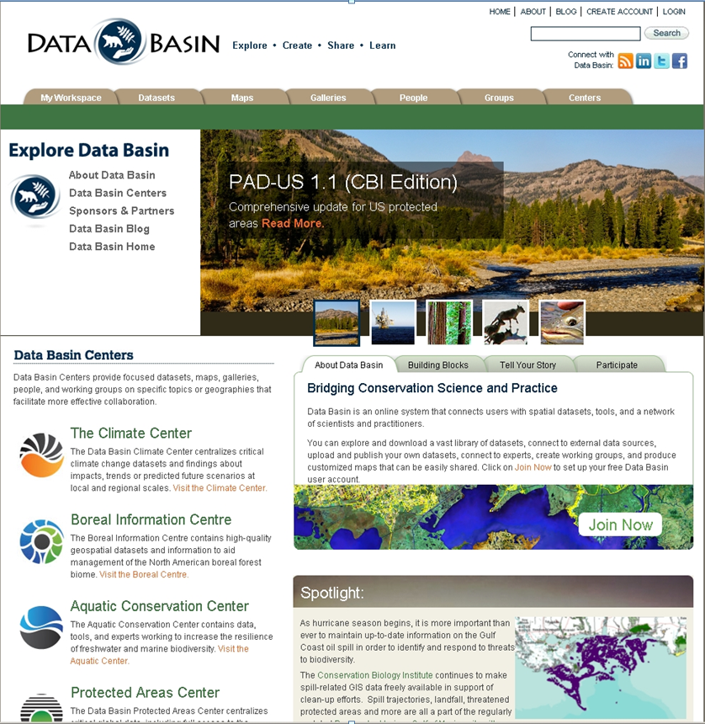
Notes:
Useful for NCED presentation

Slide 8
Data Basin Technical Details
Data Basin is entirely hosted in the Amazon Web Services cloud. We are building the capability to host the secure data on private servers.
It is architected with the following: Web server: glassfish 2.1.1 application server (Java) Database server: MySQL 5.1 Map server: ArcGIS Server (ESRI, version 10.0) ArcGIS.com software
The front-end that runs in the web browser is built using HTML, CSS, and Javascript (mostly using the Dojo Toolkit).
All you need to use Data Basin is a compatible web browser (FireFox, etc).
In terms of software required to get data into Data Basin, it is currently a requirement to have ArcGIS 9.3.1 or newer, since we require uploads in layer package format. File formats inside the layer package are either ESRI Shapefile or ArcGRID (both of which have been around many years).
We have built support for external map services. Currently we are only planning to support ArcGIS Map Server services, from version 9.3.1 or newer.
To download Data from Data Basin, it is most helpful to have ArcGIS Desktop software. However, both shapefile and ArcGRID can be consumed in third party or open source GIS tools.

Slide 9
Status of Thematic Network Data
Integrated in the
IABIN Data Integration and Analysis Gateway

Slide 10
Species and Specimens TN
Invertebrates |  | 1,025,847
Arachnids |  | 10,877
Crustaceans |  | 10,360
Coleoptera (beetles): |  | 274,449
Lepidoptera (butterflies, moths) |  | 361,922
Hymenoptera (bees, wasps) |  | 168,950
Diptera (flies) |  | 120,404
Other insects |  | 76,656
Other Arthropods |  | 2,229
Other invertebrates |  | 79,375
Molluscs |  | 60,107
Other invertebrates |  | 19,268
Vertebrates |  | 1,179,391
Mammals |  | 186,087
Birds |  | 763,173
Amphibians |  | 52,946
Reptiles |  | 61,320
Fish |  | 115,630
Other vertebrates |  | 235

Slide 11
Species and Specimens TN
Bacteria |  | 1,048
Bacteria |  | 1,048
Fungi |  | 41,583
Ascomyctes |  | 19,888
Basidiomycetes |  | 20,108
Other fungi |  | 1,587
Plants |  | 1,113,913
Ferns, mosses, and allies |  | 125,596
Algae and allies |  | 2,844
Gymnosperms |  | 5,461
Monocots |  | 164,941
Dicots |  | 810,881
Protozoa |  | 4,190

Slide 12
Pollinators TN
Original Records 1,140,000
Records with Lat-Long 769,321
LA Records with Lat-Long 446,315
Unique LA Records with Lat-Long 17,067

Slide 13
Invasive Species TN
1,926 Invasive Species records

Slide 14
Protected Areas TN
7,042 Protected Areas records

Slide 15
Ecosystems TN
Freshwater 773,704
Terrestrial 1,012,167
Ecoregions 99,919

Slide 16
Amount of Thematic Networks Records in the Data Integration and Analysis Gateway
SSTN 3,441,157 records
ETN 1,885,790 records
I3N 1,926 records
PATN 7,042 records
PTN 17,067 records
TOTAL 5,352,982 records

Slide 17
Video Demonstration

Slide 18
Next Steps & Concerns
Create transparent and dynamic links to IABIN.net and TN websites.
Maintain links to Thematic Networks to ensure consistency and currency of data.
Complete multi-language functionality for English, Spanish and Portuguese.
Fine tune data intersection analysis and reporting tools.

Slide 19
Prepare for IABIN Phase II
A significant amount of tools have been developed and standardized biodiversity and conservation data has been integrated through the support of IABIN GEF Phase I funding.
IABIN Phase II funding would provide customized access to IABIN data and tools to support targeted conservation and development applications across Latin America and the Caribbean.

Slide 20
IABIN DIAG Phase II: Focal Applications
Advance biodiversity baselines for each nation along with a set of environmental indicators.
Identify critical conservation areas throughout Latin America and the Caribbean.
Support the development, implementation and monitoring of National Biodiversity Strategy and Action Plans through improved acquisition of baseline biological and ecological information.
Support the implementation of national, regional and project level environmental assessment and monitoring programs.
Integrate ecosystem service value information critical for sustainable development across the region with the biodiversity and conservation values.
Identify significant threats and change agents that could alter the landscape integrity for these biodiversity and ecosystem service values.

Slide 21
Questions / Preguntas

Slide 23
Data Basin Background

Slide 24
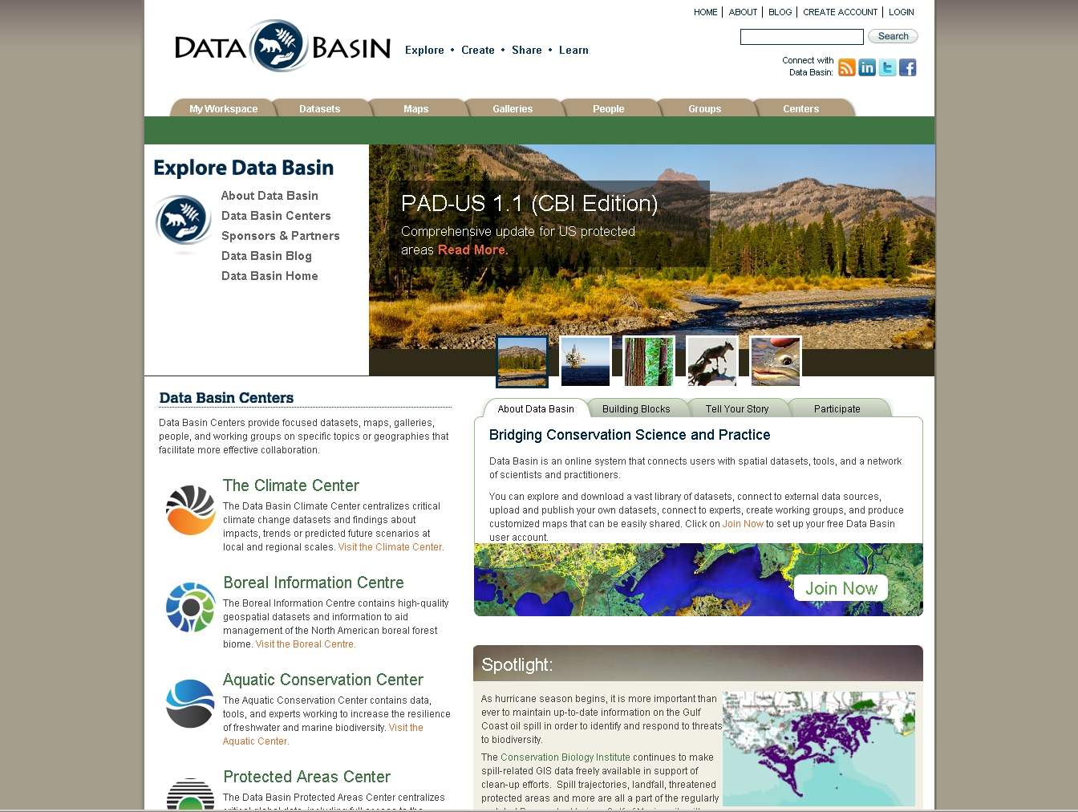
Notes:
Useful for NCED presentation

Slide 25
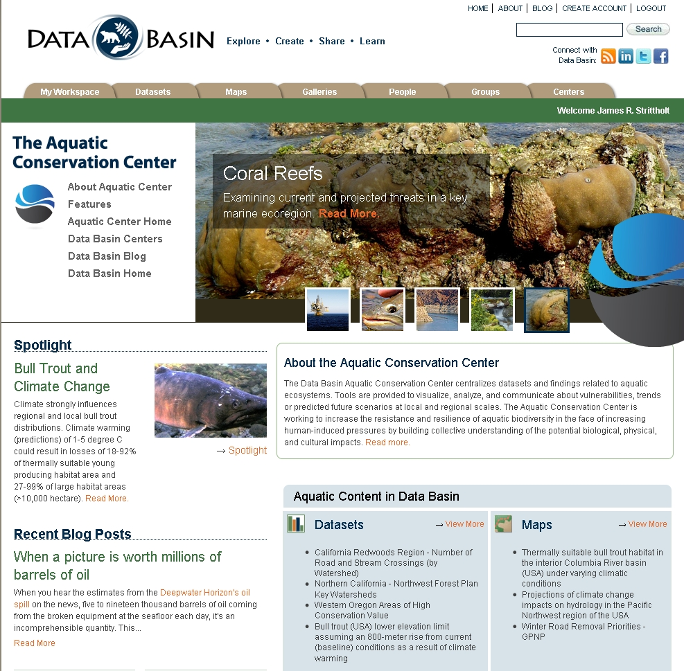
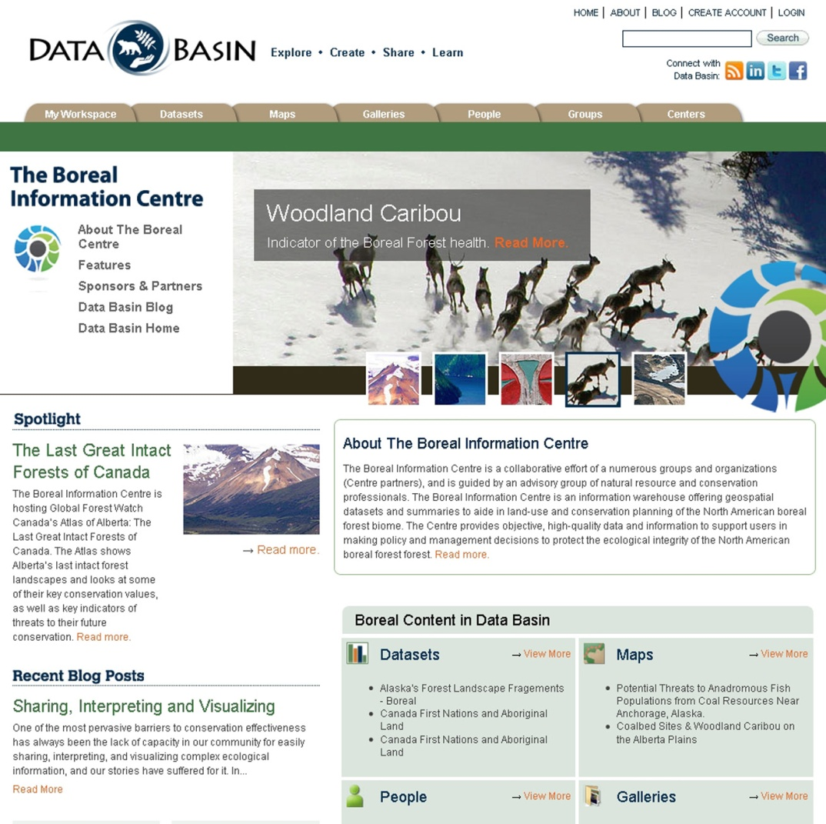
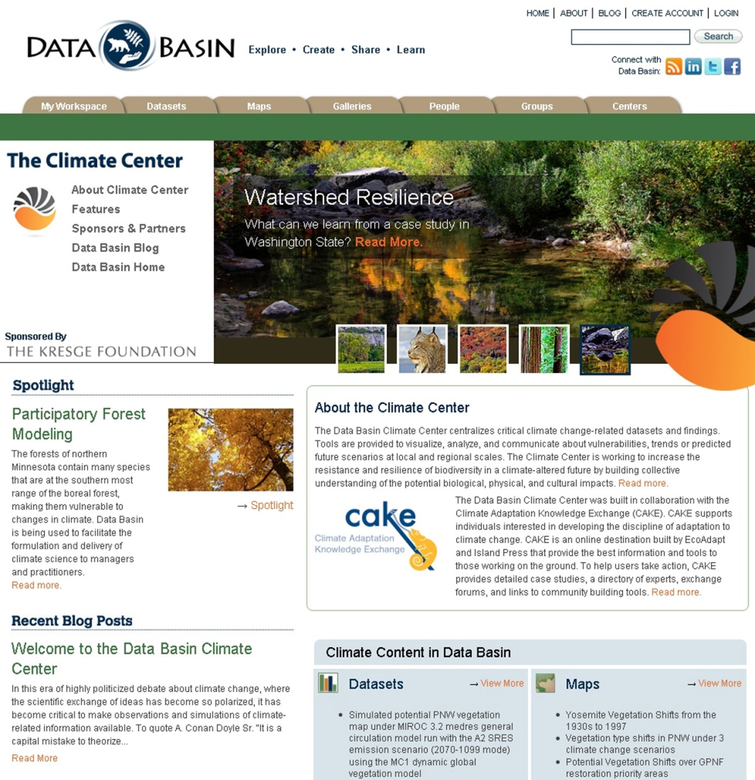
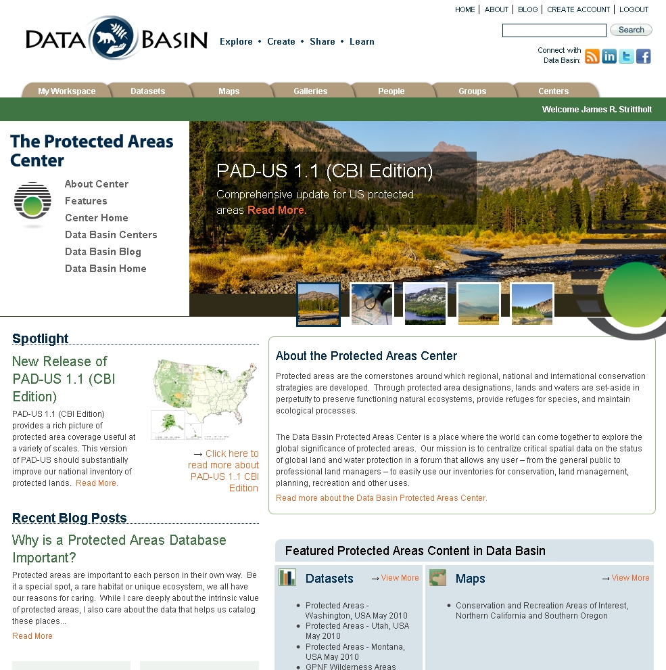
Data Basin Centers
Data Basin Centers
Notes:
Useful for NCED Presentation

Slide 26
Regional Conservation Planning Database

Slide 27
Notes:
This is the Home Page for the IDB Environmental Safeguards Group in Data Basin. They can store all of their information here, impose different levels of security regarding who can see and use the data, and work as a team to develop maps and other materials.

Slide 28
Notes:
This map depicts the areas that conform to the IDB Policy definition of Critical Natural Habitat. These data layers were developed by different members of the NGO Infrastructure Working Group.

Slide 29
Notes:
This slide demonstrates three roads that are proposed to be built by multi-lateral bank funding in the near future. One is the Pasta – Macoa in Colombia, the second is the Pucallpa – Cruziero do Sul road linking Peru and Brazil, and the third is the Loja – Jaen road linking Ecuador and Peru. The ability to spatially view these infrastructure projects in relation to areas of conservation value is now a standard step in the IDB project assessment process.

Slide 30
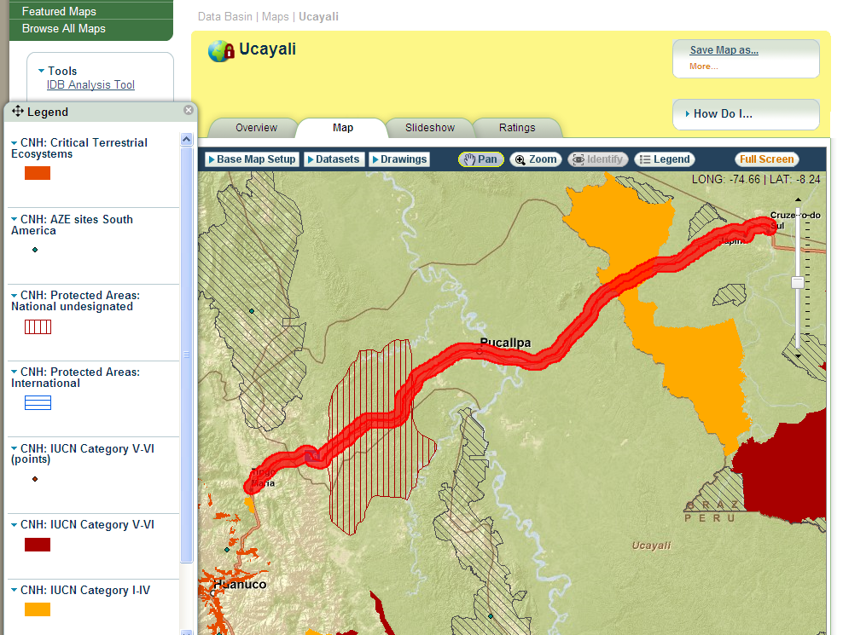
Notes:
This tool allows the user to import or draw an infrastructure project on a map and to create a buffer of an appropriate size. This is a close up of the Pucallpa – Cruziero do Sul road with buffer and the conservation priorities that it intersects.

Slide 31
Notes:
The tools has to analytical functions that allow the user to report the intersection between any project and the conservation information in that region. This demonstrates a simple report on the potential impacts of the Pucallpa – Cruziero do Sul road.

