Slide 1
Canadian Business Women in
International Trade (BWIT) Program
Global Affairs Canada
OAS WORKING GROUP 3: OCTOBER 25, 2016
Josie L. Mousseau, Deputy Director
Business Women in International Trade

Slide 2

Business Women In International Trade (BWIT)
Global Affairs Canada
Canadian Businesswomen
BWIT Program
Resources and Support
Global Trends

Slide 3
Global Affairs Canada - Mandate
Manages Canada's diplomatic and consular relations;
Leads Canada’s international development and humanitarian assistance;
Promotes the country's international trade.

Slide 4
BWIT Program @ Global Affairs Canada
Canadian Business Women in International Trade (BWIT) Program, the only national program advocating and supporting women entrepreneurs to take advantage of international trade opportunities.

Slide 5
Canadian Business Women
Definition of a women-owned business in Canada
Business that is 51%+ owned and operated by a woman or women

Slide 6
Canadian Business Women
Highly engaged in entrepreneurship
  48% of small and medium-sized enterprises (SME) are wholly or partially owned by women
Expanding at unprecedented rates
  Start-up rate is twice the rate of men
  Number of businesses doubled over the last 10 years
Contributing significantly
  Over 1.5 million jobs for Canadians
  Majority women-owned SMEs contributed almost $150 Billion in economic activity in Canada in 2011 (RBC, 2013)
  10% rise in the number of female majority-owned businesses over the next decade would boost the Canadian economy by nearly $50 Billion
Notes:
RBC 2013
Female SME exporters participated in typically export-intensive industries much more frequently than their non-exporting counterparts. For example, 16.0 percent of female SME exporters were manufacturing enterprises in 2014. Meanwhile, only 2.4 percent of female SME non-exporters were manufacturing enterprises that year. Logically, Female SME non-exporters were more likely to be located in low export propensities including the health, information, and arts and retail trade industries
Women are active in: retail; services (financial/HR); agricultural products; consumer products; education; information and communications technologies sectors
Transportation and Warehousing
Wholesale Trade
Accommodation
Agri-Food and Food Services
Retail Trade
Manufacturing
Health, Information, and Arts
Professional and Technical Services

Slide 7
Canadian Business Women
Education
  Over 65% have a college or university degree
  Nearly 30% speak at least two languages
Statistics
  In 2014, female SMEs represented 15.7 percent of all SMEs
  11.8% of Canadian majority women-owned SMEs are exporting (2014)
  40% of sales are generated via foreign markets
Experience
  Average of 15 years industry experience
  88% are founders of their firms
  Most set aggressive growth targets
Notes:
Report on Business Women’s propensity to Export which will be released next week shows that
Businesses with owners born outside of Canada are somewhat more likely to export compared to SMEs with owners born in Canada.
Foreign-born SME owners might be more likely to export given their foreign market knowledge, but they may also have less business opportunities compared to Canadian-born owners
14.1 percent of SMEs with owners born outside of Canada exported in 2014. (This was higher than owners born in Canada whose export propensity was 11.0 percent that year. )
Female SME exporters are somewhat more likely to be born outside of Canada compared to their non-exporting counterparts.
In 2014, 28.0 percent of female SME exporters had owners who were born outside of Canada.

Slide 8
BWIT Program @ Global Affairs Canada
Mandate - Canadian Business Women in International Trade:
Government of Canada program for Business Women which is focused on supporting business women to achieve international success.

Slide 9
BWIT Program - Key Stakeholders
Internal Clients
  Minister of International Trade, Global Affairs Department, other government departments
External Clients
  Canadian businesswomen and their associations, Regional Partner Organizations, Supplier Diversity certification bodies (WEConnect International in Canada, WBE Canada, CAMSC), Organization of Women in International Trade (OWIT), academia, think tanks
International Fora
  Contribute to initiatives to advocate the needs of women entrepreneurs (APEC, OECD, G/W20, G7, ITC Geneva)
  WEConnect International
  OWIT

Slide 10
BWIT Program - Internal Clients
  Awareness Building
    Strategically recommend target events for Ministerial / high-level participation
    Work with Trade Commissioner Service (TCS) in Regional Offices across Canada and +160 Posts abroad
    Connect TCS staff with business women ready to export
      Training modules – newly posted foreign service staff
    Presence on Canadian government’s WIKIPEDIA
    Articles in departmental newsletter on trade – eg. CanadExport
  Policy Building
    Member of Interdepartmental SME committee
    Work with colleagues on women’s economic empowerment and contribute to initiatives on women in trade with international fora
    Partner with Other Government Departments
Notes:
Recently negotiated a MOU with the United States and Mexico to reduce barriers to trade. The MOU was signed at the NALS in Ottawa this past June.
Partner with OGDs - on events focusing on women entrepreneurs, event scheduled in Toronto on Nov. 9th hosted by Minister Chagger, Minister of Small Business and Tourism and House Leader;
Use PGD social media platforms to increase awareness of support and services through - Blogs, reciprocal links

Slide 11
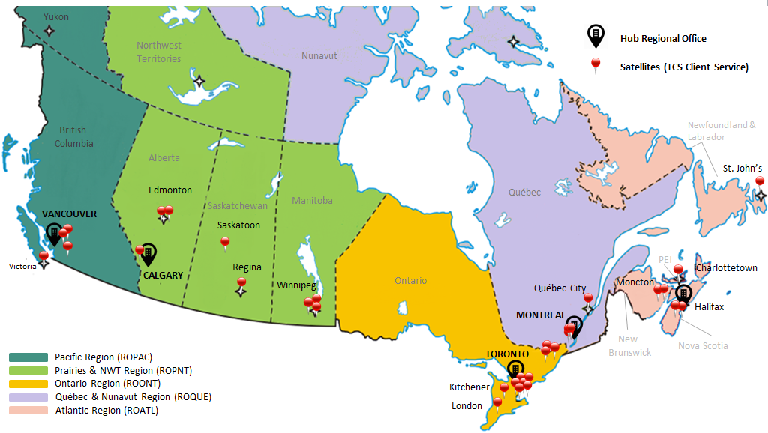


Trade Commissioner Service Regional Network

Slide 12
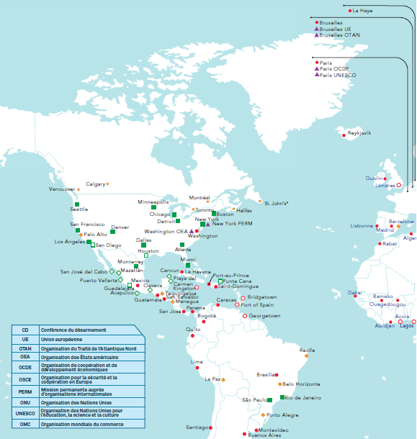
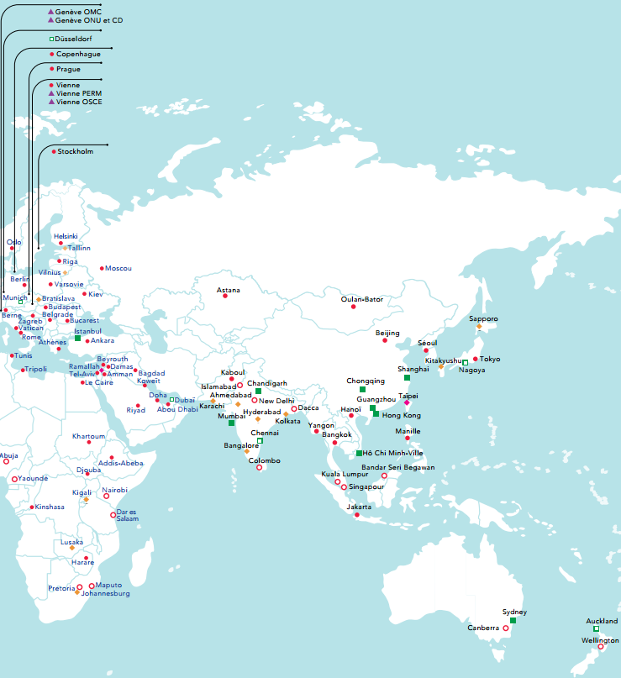


Trade Commissioner Service - Missions Abroad
Contact
deleguescommerciaux.gc.ca
1-888-306-9991 (Sans frais)

Slide 13
BWIT Program - External Clients
  Public Sector in Regions:
    Regional Development Agencies – work to foster economic development in specific regions of Canada through targeted business development programs for women
  Private Sector:
    Business women’s associations across the country
    Supplier diversity certifying bodies

Slide 14
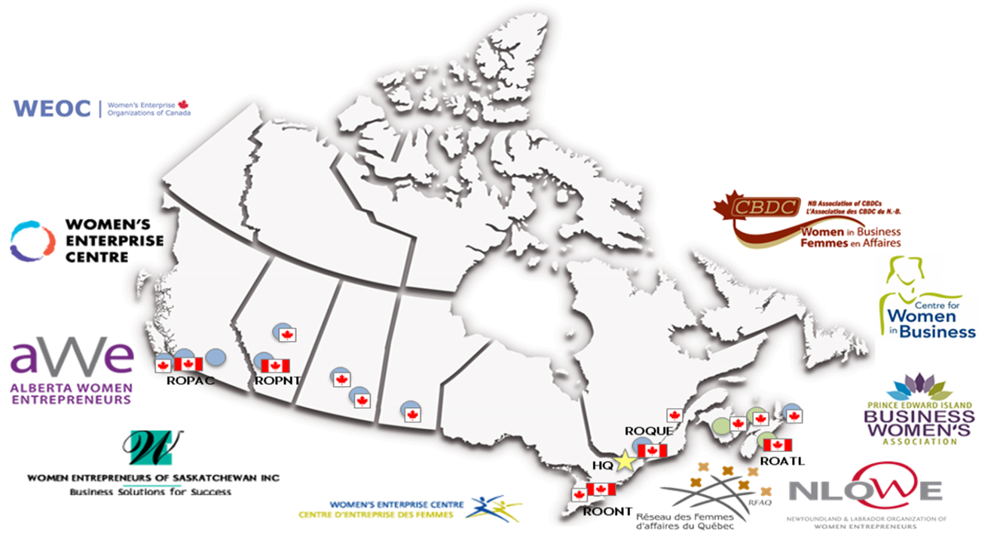



BWIT Program - Stakeholders
Notes:
Federal Government:
Economic and social policies, agendas and networks inform the actions of the Departments of: Status of Women; Innovation, Science and Economic Development; Heritage Canada; Global Affairs Canada*; Regional Partner Organizations = business women’s associations across Canada
Regional Governments:
Economic Development Agencies – west = Western Economic Development, East = Atlantic Canada Opportunities Agency; Provinces

Slide 15
BWIT - Resources and Support
Awareness building
Women-focussed Trade Missions
BWIT website
Monthly and Annual Newsletters
Social media presence
Notes:
These are the tools we use. Following slides will give you more details on these and then situate them with our clients and partners

Slide 16

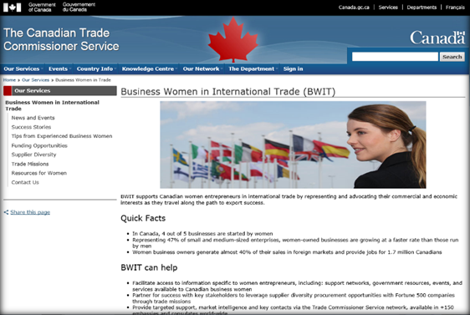
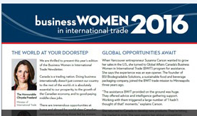
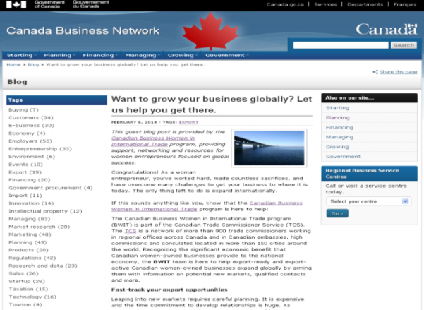
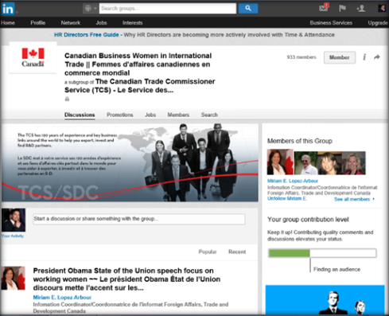
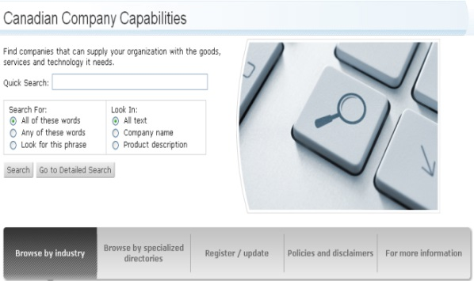
BWIT – Resources and Support
Trade Missions
BWIT Website
businesswomenintrade.gc.ca
Monthly & Annual BWIT Newsletter
Directory of women-owned businesses
ic.gc.ca/bwit
LinkedIn Group
  http://linkd.in/bwit-faci
Blogs
Available on Canada Business Network

Slide 17
Some Key Global Trends in Women’s Entrepreneurship
Connecting Women Entrepreneurs to Contracts
Supplier diversity:
Provides access to lucrative contract set-asides reserved by 97% of Fortune 500 companies for traditionally under-represented groups such as minority and women-owned businesses.
Notes:
Supplier diversity is the strategic business process of corporations reaching out to groups not traditionally included in their supply chains, including women-owned businesses that want to compete for contracts.
It means implementing processes to identify, vet and match under-represented suppliers to procurement opportunities and then measuring achievements. Utilizing a supplier base that reflects the growing diversity of businesses in particular and the population in general makes good business sense.
Women are involved in 85% of purchasing decisions, and are bringing quality products and services to the marketplace at an escalating pace. Despite this, they receive a very small fraction of large contract opportunities.
Supplier diversity is a market access opportunity for certified businesses, enabling them to have a fair opportunity to tender for contracts. After that, it is business as usual - women's firms must go through the standard corporate or government tendering process, and be assessed on their merits with no regard to gender.

Slide 18
Notes:
Supplier Diversity Opportunities
Although supplier diversity has become firmly rooted in the American corporate world, after having emerged in the United States nearly 15 years ago, this movement has only recently extended its reach to Canadian suppliers.

Slide 19
Connecting Women Entrepreneurs to Contracts
Supplier diversity:
BWIT was instrumental in introducing certification to Canadian entrepreneurs, and it is now offered by:
WBE Canada
    Provides a range of programs and services, including certification
WEConnect International (in Canada)
    Certifies women’s businesses around the globe – 19 Chapters
Canadian Aboriginal and Minority Supplier Council (CAMSC)
  CAMSC certifies Aboriginal and minority businesses.
Notes:
As a result, Canadian women-owned businesses are gaining additional leverage to access lucrative contract set-asides reserved by 97 percent of Fortune 500 companies for traditionally under-represented groups such as minority and women-owned businesses.

Slide 20
Some Key Global Trends in Women’s Entrepreneurship
Progress: Shifting Conversations
  Prime Minister
    Gender-balanced cabinet, a 1st for Canada
  Minister of International Trade
    Committed to diversity, including gender equality
  North American Leaders’ Summit
    June 2016 MOU signed on Women Entrepreneurs
  International Fora
    Women’s economic empowerment as part of fabric and goal setting processes. Examples include: APEC, W20, UN, IMF, OECD, ITC Geneva, IDB, OAS, 30% Club
Notes:
IMF, Christine Lagarde
Could add ref to 30% Club, 2020 targets of ITC Geneva “Call to Action”

Slide 21
THANK YOU!
Connect with the BWIT Team:
Josie L. Mousseau – Deputy Director
Lynne Thomson – Trade Commissioner
Edith Morency – Trade Commissioner
Miriam Lopez-Arbour – Information Coordinator
Paige Kirk – Program Officer
E-mail: bwit@international.gc.ca
linkd.in/bwit-faci
businesswomenintrade.gc.ca

